Slide 1
Integration Architecture
Peter Ritchie

Slide 2

Peter Ritchie
Author
Speaker
Software Architect
In my 3rd decade of professional software technologist
More than 3rd decade writing software
@PeterRitchie
Peter.Ritchie@Outlook.com

Slide 3
Motivation
Layered Architecture

Slide 4
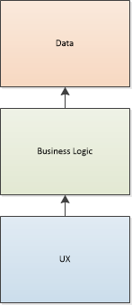
Layers

Slide 5
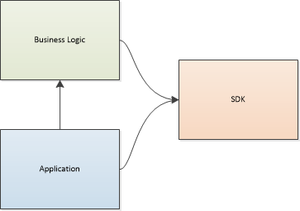
Reality

Slide 6
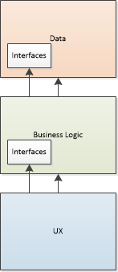
Attempt at Reality

Slide 7
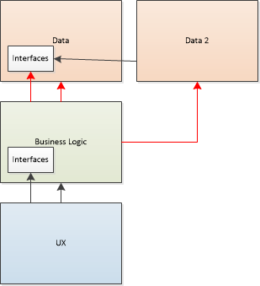
Reality

Slide 8
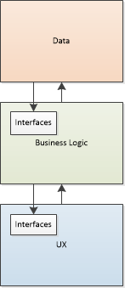

Slide 9
Loose Coupling!

Slide 10
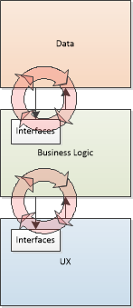
Loose Coupling?

Slide 11
The Integration Architecture Style
BADASS
AKA: Bridge Application Domain Architectural Structure Standard
Hyper-focused on facilitating integration/composition
Clean/Hexagonal Architecture
Domain Driven Design
“Fractal”
Bridge
Sheppard data from public facing to implementation
Application
An application of the domain
Domain
domain-specific concepts and logic
Notes:
Shepard/marshal. I didn’t like “marshal”, but if you’re familiar with the term that’s what I’m getting at.
And yes, that is the acronym BADASS

Slide 12
Domain
/dōˈmān/
noun
a sphere of knowledge, influence, or activity
Hierarchical, domains (sub-domains) within a domain
Domains are sub-domains of other domains.
Typically knowledge and activity scoped to provide business value
The Business Logic in a n-tier architecture
Nouns, Verbs
Parameters, activities, outcomes (inputs, process, outputs)
Entities, Aggregates, Behavior (aka Domain Driven Design)
The Why?

Slide 13
Application
An application of a domain.
A set of use cases that use the domain
Use of Domain within an infrastructure
Notes:
Use cases: ala hexagonal

Slide 14
Bridge
Domains are islands
Bridges connect islands together without creating one larger island
Allows island to retain its unique characteristics
Eliminates influence by other domains
Use of a domain is an application of domain, bridges bridge applications.

Slide 15
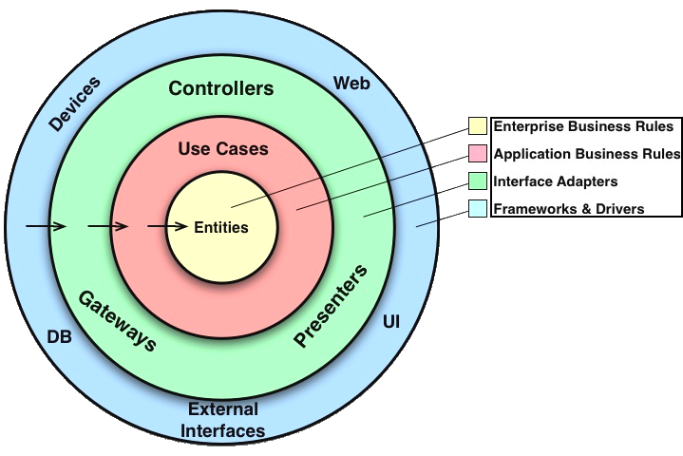
Clean

Slide 16
Clean
Bridge
Application
Domain

Slide 17
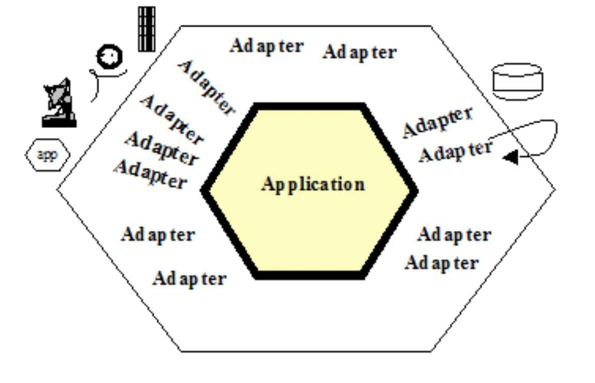
Hexagonal

Slide 18
Hexagonal
Bridge
Application
Domain

Slide 19
Fractal-like Pattern
Notes:
One applications infrastructure is another domain application’s bridge.

Slide 20
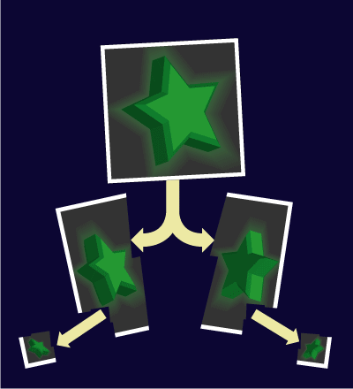
…or Holograms
Notes:
The hologram is the design/architecture of the component.

Slide 21
Client/Server
Bridge, Application, Domain is a implementation of a server
Clients make requests to servers
Control flow
Consumer/Producer
Caller/Callee
Driver/Driven

Slide 22
Fractals

Slide 23
Client App
Entity Service
Task Service

Slide 24
MVC?
Infrastructure 1
Model
View
Controller
Infrastructure 2
Windows, Azure, Linux, etc.
Model/View acts as a bridge to request pipeline/stack/etc.
Controller should bridge to Infrastructure 2 via abstractions
Application knows about infrastructure, but Controller should not.

Slide 25
Console?
Infrastructure 1
Program
Configuration (arguments, parameters, secrets)
Infrastructure 2
Windows, Azure, Linux, etc.
Program acts as bridge to inputs (configuration)
Program should bridge to Infrastructure 2 via abstractions
Program invokes Domain with abstractions

Slide 26
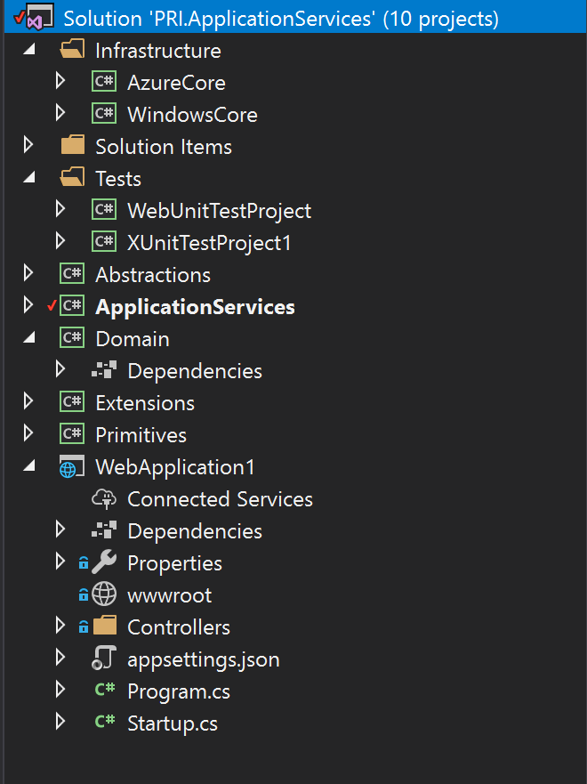
Clarity Through a More Common Language

Slide 27
Clarity Through a More Common Language
Visual Studio structure
Solution
Project
Packages

Slide 28
Success Criteria
Class libraries in .NET Standard

Slide 29
Success Criteria
Primitives project only references frameworks
Primitives project could be scoped to .NET Standard 1.0 (or 1.2 if no need to target 4.5)

Slide 30
Success Criteria - Abstractions
Abstractions Project only references Primitives
Abstractions project could be scoped to .NET Standard 1.0 (or 1.2 if no need to target 4.5)

Slide 31
Success Criteria
Extends primitives and abstractions
Extensions project only references Abstractions (Primitives indirectly)
Extensions project could be scoped to .NET Standard 1.0 (or 1.2 if no need to target 4.5)

Slide 32
Success Criteria
Application project composes infrastructure implements and provides interface references to Domain objects
Application project references Infrastructure and Domain

Slide 33
Success Criteria
Domain project only references Abstractions and Extensions. Primitives indirectly.
Domain project never references Infrastructure nor Application

Slide 34
Success Criteria
Unit/automated test as much of your success criteria as possible!

Slide 35
Take Aways
Principles apply at all levels, despite naming differences
Recognize:
Deployments just another organization of functionality
Deployment recognizes infrastructure constrains and bridges
Minimum of three layers on all levels
Vigilant about abstractions between layers
Cross-layer abstractions should be singular functionality
Notes:
Service: Function
Method: Function
Object: State and function

Slide 36
Thank You!
@PeterRitchie
http://blog.peterritchie.com/
Peter.Ritchie@outlook.com
GitHub.com/PeterARitchie

